Slide 1
WHEN CURING IS NOT AN OPTION… CARING MEANS COMFORT
Suzanne Karefa-Johnson, MD HMDC
FAMILY HOSPICE CARE

Slide 2
HIPPOCRATES- the father of medicine

Slide 3
THE VISIT TO THE DOCTOR

Slide 4
THE GRAYING OF AMERICA
10,000 Baby boomers are turning 65 each day
Every minute 7 Baby boomers turn 65
In 2035, people age 65 and over will number 77.0 million. Children under age 18 will number 76.5 million. OLDER ADULTS WILL OUTNUMBER CHILDREN

Slide 5
LEADING CAUSES OF DEATH IN AMERICA
HEART DISEASE
CANCER
UNINTENTIONAL INJURY
CHRONIC LOWER RESPIRATORY TRACT DISEASE ( asthma, COPD, pulmonary hypertension, occupational lung disease)
STROKE AND CEREBROVASCULAR DISEASE ( stroke, TIA, subarachnoid hemorrhage, vascular dementia)
ALZHEIMER’S DISEASE

Slide 6
WHERE DO CALIFORNIANS PREFER TO DIE?
70% OF CALIFORNIANS SAY THEY WOULD PREFER TO DIE AT HOME
IN 2009, 42% DIED IN A HOSPITAL, 18% DIED IN A NURSING HOME
IN 2009, ONLY 32% DIED AT HOME!

Slide 7
DYING IN THE ICU

Slide 8
DYING AT HOME

Slide 9
FINAL WISHES OF CALIFORNIANS
FACTORS THAT WERE IDENTIFIED AS MOST IMPORTANT AT THE END OF LIFE WERE:
NOT BURDENING FAMILIES FINANCIALLY
NOT SUFFERING WTH PAIN. BEING “COMFORTABLE”

Slide 10
HOW ARE THESE FINAL WISHES COMMUNICATED?
OR ARE THEY….

Slide 11
COURAGEOUS CONVERSATIONS
56% OF CALIFORNIANS HAVE NOT SHARED THEIR WISHES FOR END OF LIFE WITH THEIR LOVED ONES
80% SAY THEY WOULD TALK TO THEIR PHYSICIAN ABOUT END-OF-LIFE CARE, BUT ONLY 7% HAVE ACTUALLY DONE SO

Slide 13
ADVANCE DIRECTIVES
DEFINITION: A WRITTEN STATEMENT OF A PERSON’S WISHES REGARDING MEDICAL TREATMENT
WRITTEN TO ENSURE THAT THOSE WISHES ARE CARRIED OUT SHOULD THE PERSON BE UNABLE TO COMMUNICATE THEM TO A DOCTOR
IN CALIFORNIA, THERE IS THE OPTION OF THE POLST FORM

Slide 14
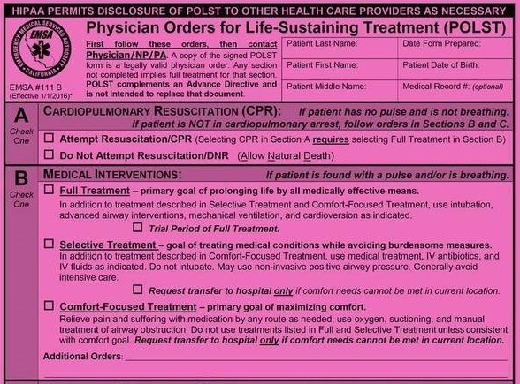
POLST- PHYSICIANS ORDER FOR LIFE SUSTAINING TREATMENT

Slide 15
FIVE WISHES

Slide 16
GOWISH CARDS

Slide 17
FOR THE MORE ADVENTUROUS

Slide 18
DEATH PHOBIA
IN AMERICA WE ARE AFRAIID TO SPEAK ABOUT DEATH
IN MEDICINE IT IS OFTEN VIEWED AS THE ULTIMATE FAILURE
WE ARE OBSESSED WITH YOUTH AND CONQUERING EVERY CHALLENGE
THERE IS ONE THING THAT EVERYONE IN THIS ROOM SHARES, OTHER THAN OUR HUMANITY…. WE WILL ALL DIE

Slide 19
THE DOCTOR’S OFFICE

Slide 20
IF NO “HOPE” OF CURE….
HOSPICE
PALLIATIVE CARE – “relief of suffering” from latin ‘palliare’- TO WRAP ONE’s ARMS AROUND
PALLIATIVE CARE IS GIVEN AT ANY POINT ALONG THE ILLNESS TRAJECTORY- PATIETNS DO NOT HAVE TO BE TERMINALLY ILL
HOSPICE- PALLIATIVE CARE AT END OF LIFE ( 6 MONTHS OR LESS PROGNOSIS)
HOSPICE FOCUSES ON SYMPTOM MANAGEMENT
/ COMFORT CARE

Slide 21
THERE IS ALWAYS “HOPE” FOR COMFORT AND QUALITY OF LIFE- HOSPICE
INTERDISCIPLINARY CARE GIVEN WHEREVER THE PATIENT “LIVES”
HOME, ASSISTED LIVING, BOARD AND CARE, NURSING HOME
MEDICARE HOSPICE BENEFIT – COVERS ALL CARE RELATED TO THE TERMINAL PROGNOSIS ( 1986)

Slide 22
QUALITY OF LIFE- HOSPICE
PATIENTS <65 COVERED BY THEIR COMMERCIAL INSURANCE
MEDICAL COVERS HOSPICE
INITIAL TWO 90 DAY BENEFIT PERIODS FOLLOWED BY UNLIMITED 60 DAY BENEFIT PERIOD AS LONG AS PATIENT IS CLINICALLY ELIGIBLE

Slide 23
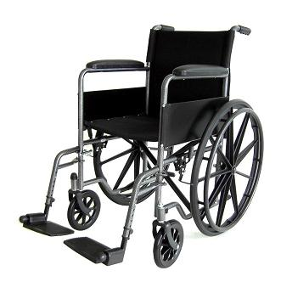
HOSPICE
“CARE” COVERS:
NURSING, PHYSICIAN, SOCIAL WORKER, SPIRITUAL COUNSELOR, HOME HEALTH AIDES
ALL MEDICATIONS RELATED TO THE TERMINAL PROGNOSIS
ALL DME NEEDED ( hospital bed, walker, bedside commode, oxygen)
SUPPLIES ( incontinence products, body washes, chucks, gloves)
UNIT OF CARE IS THE PATIENT AND THEIR “FAMILY” ( HOWEVER THEY DEFINE THAT)

Slide 24
CORE HOSPICE TEAM
NURSE ( USUALLY RNs)- CASE MANAGERS- AT LEAST ONCE /WEEK VISITS
SOCIAL WORKER- ASSISTANCE WITH FINDING COMMUNITY RESOURCES; PLACEMENT, APPLICATIONS FOR IHSS, MEDICAID, LIAISON WITH RCFE STAFF
SPIRITUAL COUNSELOR- ADDRESS EXISTENTIAL ISSUES AROUND END-OF-LIFE, COUNSELING

Slide 25
CORE HOSPICE TEAM
BEREAVEMENT- SUPPORT OF ANTICIPATORY GRIEF, INDIVIDUAL AND GROUP SUPPORT, OUTREACH TO SURVIVING FAMILY/CG/FRIENDS
PHYSICIAN-INITIAL VISIT AND FOLLOW UP VISITS AS NECESSARY; CLARIFICATION OF GOALS OF CARE: AGGRESSVE PAIN AND SYMPTOM MANAGEMENT TO MAXIMIZE QUALITY OF LIFE, EDUCATION ON DISEASE PROGRESSION/ EOL SYMTPOMS ; EOL COUNSELING AND SUPPORT; LIAISE WITH COMMUNITY PHYSICIANS

Slide 26
ADDITIONAL TEAM MEMBERS
HOME HEALTH AIDES- PROVIDE HANDS ON CARE WITH ACTIVITIES OF DAILY LIVING ( BATHING, TOILETING, DRESSING, BED CARE)
VOLUNTEERS- PATIENT ENGAGEMENT/SOCIALIZATION, CAREGIVER RELIEF
BEREAVEMENT COUNSELORS

Slide 27
HOSPICE SERVICES
“UNIT OF CARE” – PATIENT AND FAMILY
PLAN OF CARE IS DRIVEN BY PATIENT AND FAMILY’s “GOALS OF CARE”
HOSPICE IS “ON CALL” AS NEEDED, 24 HOURS/DAY, 7 DAYS?WEEK
BENEFIT EXTENDS 13 MONTHS AFTER DEATH OF PATIENT TO PROVIDE BEREAVEMENT CARE TO SURVIVING FAMILY/CAREGIVERS

Slide 28
HOSPICE LEVELS OF CARE
MOST PATIENTS ARE AT THE ROUTINE LEVEL OF CARE
SHORT-TERM INPATIENT CARE AVAILABLE FOR SYMPTOMS THAT CANNOT BE MANAGED AT HOME ( GENERAL INPATIENT CARE)
SHORT TERM CONTINUOUS CARE AT HOME FOR AGGRESSIVE SYMPTOM MANAGEMENT
RESPITE CARE IN NURSING HOME TO PROVIDE RESPITE FOR CAREGIVER(S)

Slide 29
HOSPICE MYTHS
HOSPICE MEANS YOU HAVE GIVEN UP
HOSPICE CARE HASTENS DEATH
HOSPICE ONLY LASTS FOR 6 MONTHS
HOSPICE MEANS YOU HAVE TO GIVE UP YOUR OWN PHYSICIAN

Slide 30
HOSPICE MYTHS
HOSPICE IS ONLY FOR THOSE WITH DAYS OR WEEKS TO LIVE
HOSPICE IS A PLACE AND YOU HAVE TO LEAVE YOUR HOME
HOSPICE MEANS YOU HAVE TO GIVE UP CONTROL
HOSPICE IS ONLY FOR PATIENTS WITH CANCER
HOSPICE HASTENS DEATH THROUGH USING MORPHINE

Slide 31
HOSPICE FACTS AND FIGURES- TOP FIVE DIAGNOSES
CANCER – 30%
HEART – 17.6%
DEMENTIA – 15/6%
RESPIRATORY- 11.0%
STROKE – 9/4%
TAKE AWAY- 70% OF HOSPICE PATIENTS DO NOT HAVE A CANCER DIAGNOSIS
27.8% OF HOSPICE PATIENTS ARE ENROLLED IN HOSPICE FOR SEVEN DAYS OR LESS!
TAKE AWAY- PEOPLE SPEND UP TO A YEAR PLANNING THE “VACATION OF A LIFETIME”!

Slide 32
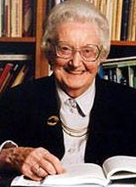
DAME CICELY SAUNDERS 1918-2005
GRANDE DAME AND FOUNDER OF THE MODERN HOSPICE MOVEMENT
NURSE, SW AND PHYSICIAN
INTRODUCED CONCEPT OF “ TOTAL PAIN”

Slide 33
TOTAL PAIN
PHYSICAL/SOMATIC
PSYCHOLOGICAL
SOCIAL
SPIRITUAL
FINANCIAL

Slide 34
SUFFERING- ESSENTIAL PART OF LIFE –LOSS, GRIEF, HEARTBREAK
SUFFERING- THAT WE CAN IMPACT
HOSPICE/PALLIATIVE CARE- MISSION TO RELIEVE SUFFERING
BEING ALIVE IS A FATAL CONDITION- ATUL GAWANDE

Slide 35
HOPE SPRINGS ETERNAL- ALWAYS SOMETHING TO HOPE FOR
ATTEND TO END OF LIFE PLANNING WAY BEFORE ITS NEEDED ( ADVANCE DIRECTIVES/COURAGEOUS CONVERSATIONS)
IF YOU OR SOMEONE YOU KNOW HAS BEEN DIAGNOSED WITH A TERMINAL ILLNESS, DISCUSS THE POSSIBILITY OF HOSPICE WITH YOUR PHYSICIAN(S)

Slide 36
THE HOSPICE PROMISE
“YOU MATTER BECAUSE YOU ARE YOU, AND YOU MATTER TO THE END OF YOUR LIFE. WE WILL DO ALL WE CAN NOT ONLY TO HELP YOU DIE PEACEFULLY, BUT ALSO TO LIVE UNTIL YOU DIE” - CICELY SAUNDERS

Slide 37
THANK YOU FOR YOUR GIFT OF PRESENCE

