Slide 1
Friendship
“Apart from family, how many close friends do you have?”

Slide 2
Friendship Number: Gender
Mean = 5.4

Slide 3
Friendship Number: Gender and Age
Men
Women

Slide 4
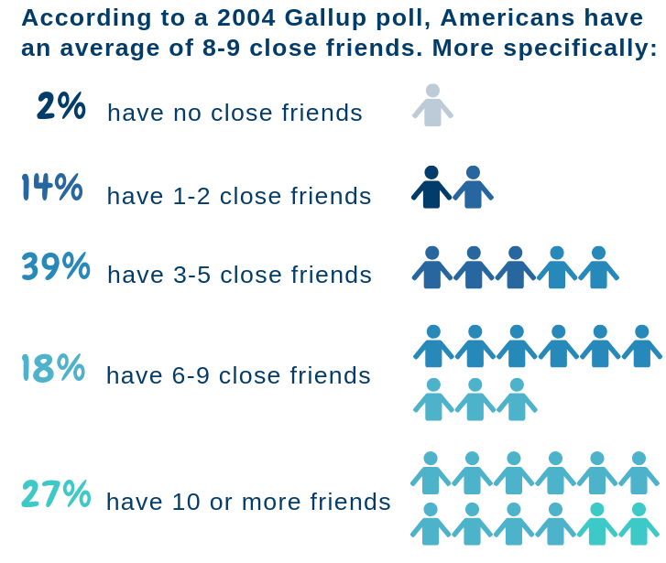
Friendship Number: Gallup Poll

Slide 5
Elements of Friendship Definition
Behavioral—what we do with friends (assist, shared activities)
Cognitive—what we think about our friends (loyalty, trust)
Affective—how we feel about our friends (care, love)
Structural—what we do with our friends (proximity, similar social status)
Proxy—a stand-in measure for things like length of time we have known our friends, how often we see each other

Slide 6
Percentage Dimensions by Gay/Lesbian and Heterosexual

Slide 7
Percentage Dimensions by Region

Slide 8
Percentage Dimensions by Cultural/Racial Group

Slide 9
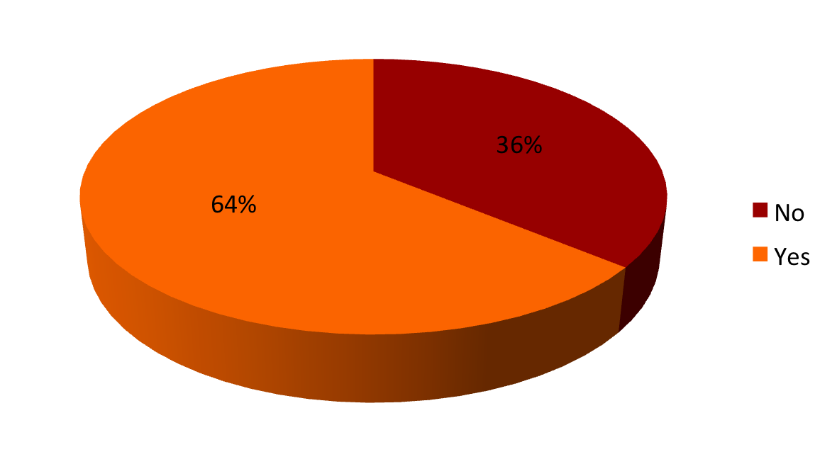
LGBT Boomers with Chosen Family (MetLife study, 2010)

Slide 10
Sources to Whom Respondents Turn for Emotional Support (PALS survey)

Slide 11
Ratings of Frequency of Receipt of Emotional Support (PALS survey)

Slide 12
Sources to Whom Respondents Turn for Short-Term Help (PALS survey)

Slide 13
Sources to Whom Respondents Turn for Long-Term Help (PALS survey)

Slide 14
Comparing Individual Sources of Support: Friend, Relative, Neighbor, and No One (PALS survey)

Slide 15
Ambiguous Role of Friends
Few formal roles for friends
Not often recognized in healthcare settings
Don’t qualify as “next of kin” (e.g., bereavement leave)
May be viewed with suspicion as caregivers
--
Need to be more conscious, intentional with friends
International Friendship Day is July 30, 2021

